Slide 1

EE-371 : Control Systems
Lecture#40,41,42
FREQUENCY RESPONSETECHNIQUES
10.1 Introduction, 534
10.2 Asymptotic Approximations of Bode Plots
10.7 Stability, Gain Margin, and Phase Margin via Bode Plots
10.8 Relation Between Closed-Loop Transient and Closed-Loop Frequency Responses
10.10 Relating Damping Ratio and Phase Margin
Textbook: Chapter # 10 (5th edition)
Text Book: Control Systems Engineering by Norman S. Nise 5th Edition
Instructor: Ms Neelma Naz
Class: BEE12 C/D
School of Electrical Engineering and Computer Science
Department of Electrical Engineering

Slide 2
FREQUENCY RESPONSE TECHNIQUE

Slide 3
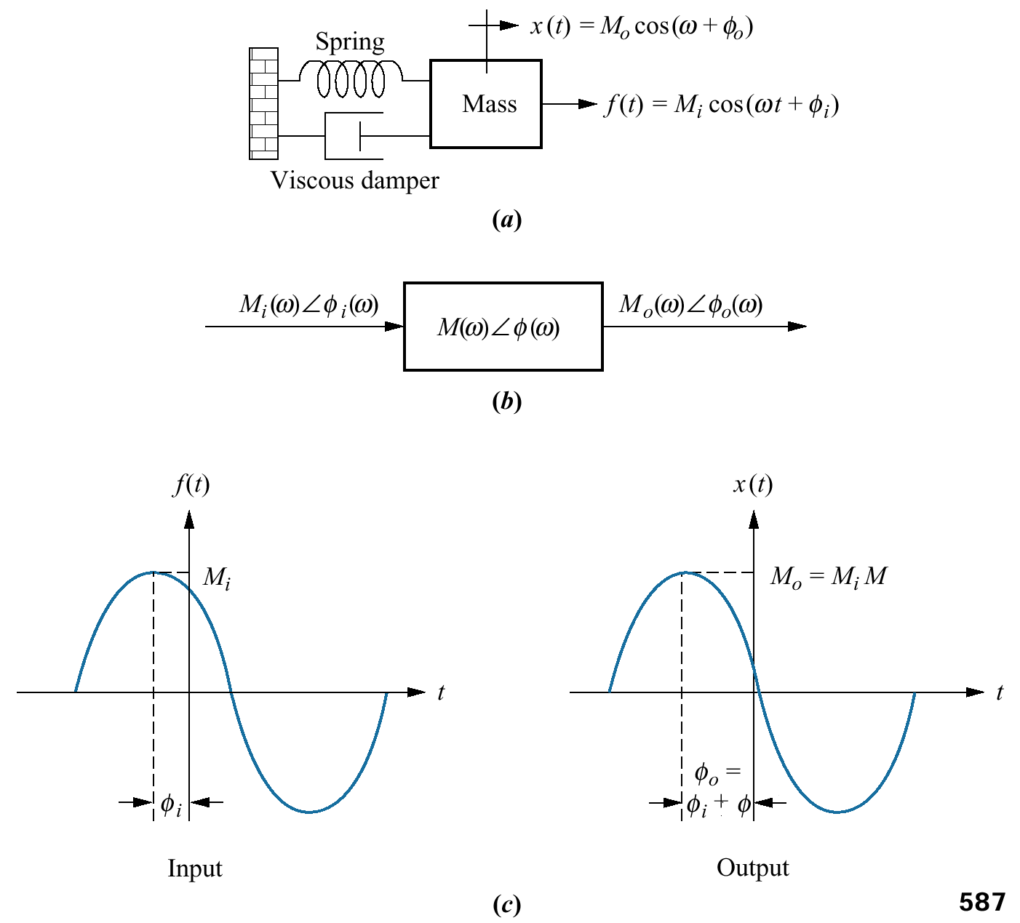
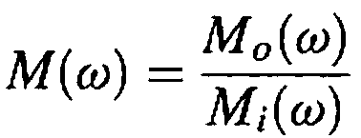

The Concept of Frequency Response
The input and output sinusoids are
represented by complex numbers:
M's are the amplitudes
Φ's are the phase angles
of the sinusoids
The system function is given by

Slide 4

Magnitude frequency response
Both responses are a function of frequency and apply only to the steady state sinusoidal response of the system
Phase frequency response
The combination of magnitude and phase frequency responses is called the frequency response

Slide 5
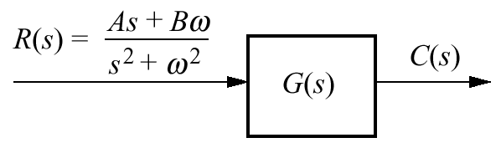
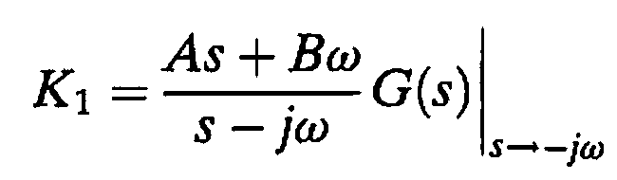
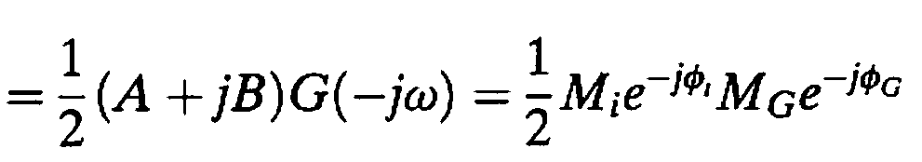

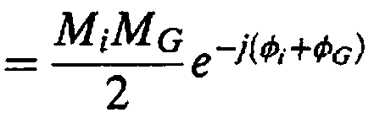


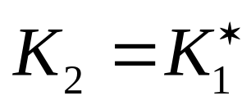

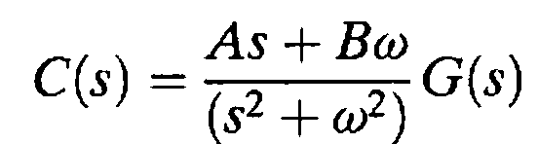
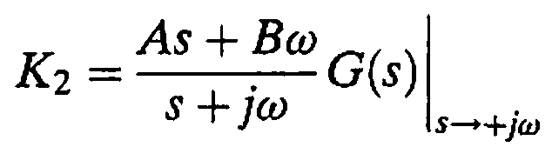
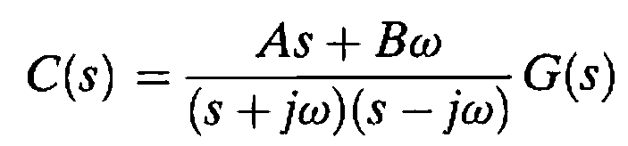
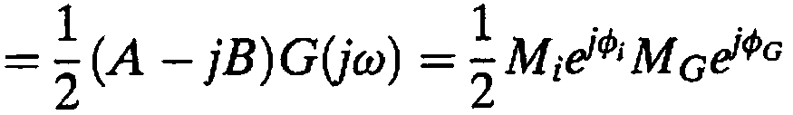
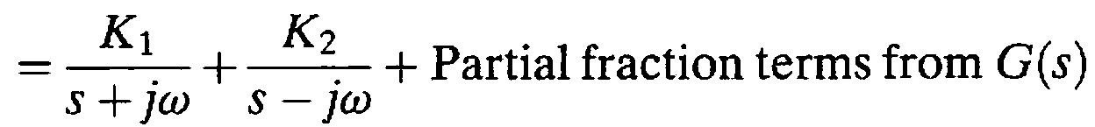
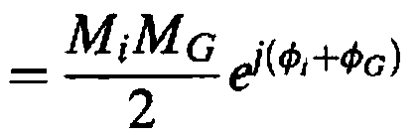
System with
sinusoidal input
Input to the system is Laplace transform of a general sinusoid
r(t) = A cos ωt + B sin ωt
The input can be represented as a phasor in three ways

Slide 6


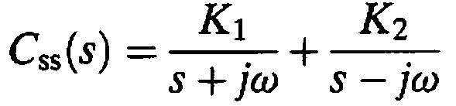
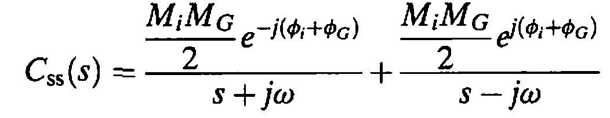
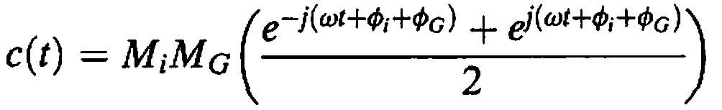


K₁
K₂
The sinusoidal steady-state output, C_{ss}(s), comes from the input waveform's poles and is expressed as:

Slide 7
Plotting Frequency Response
G(jω) can be plotted as:
A function of frequency, with separate magnitude and phase plots
The magnitude curve is plotted in
decibels (dB) vs. log ω, where dB = 20 log M.
The phase curve is plotted as phase angle vs. log ω
(2) A polar plot, where the phasor length is the magnitude and the phasor angle is the phase

Slide 8
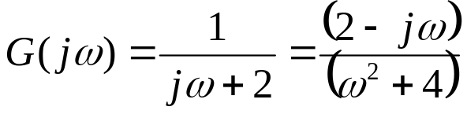
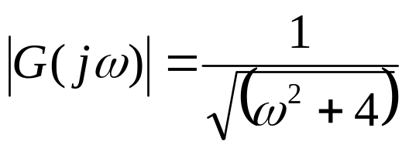

Example 10.1
Frequency Response from The Transfer Function
PROBLEM: Find the analytical expression for the magnitude frequency response and the phase frequency response for a system G(s) = 1/(s + 2). Also, plot both the separate magnitude and phase diagrams and the polar plot.
SOLUTION:
substitute s = jω in the system function
The magnitude of this complex number
The phase angle of G(jω)
the magnitude frequency response
the phase frequency response

Slide 9
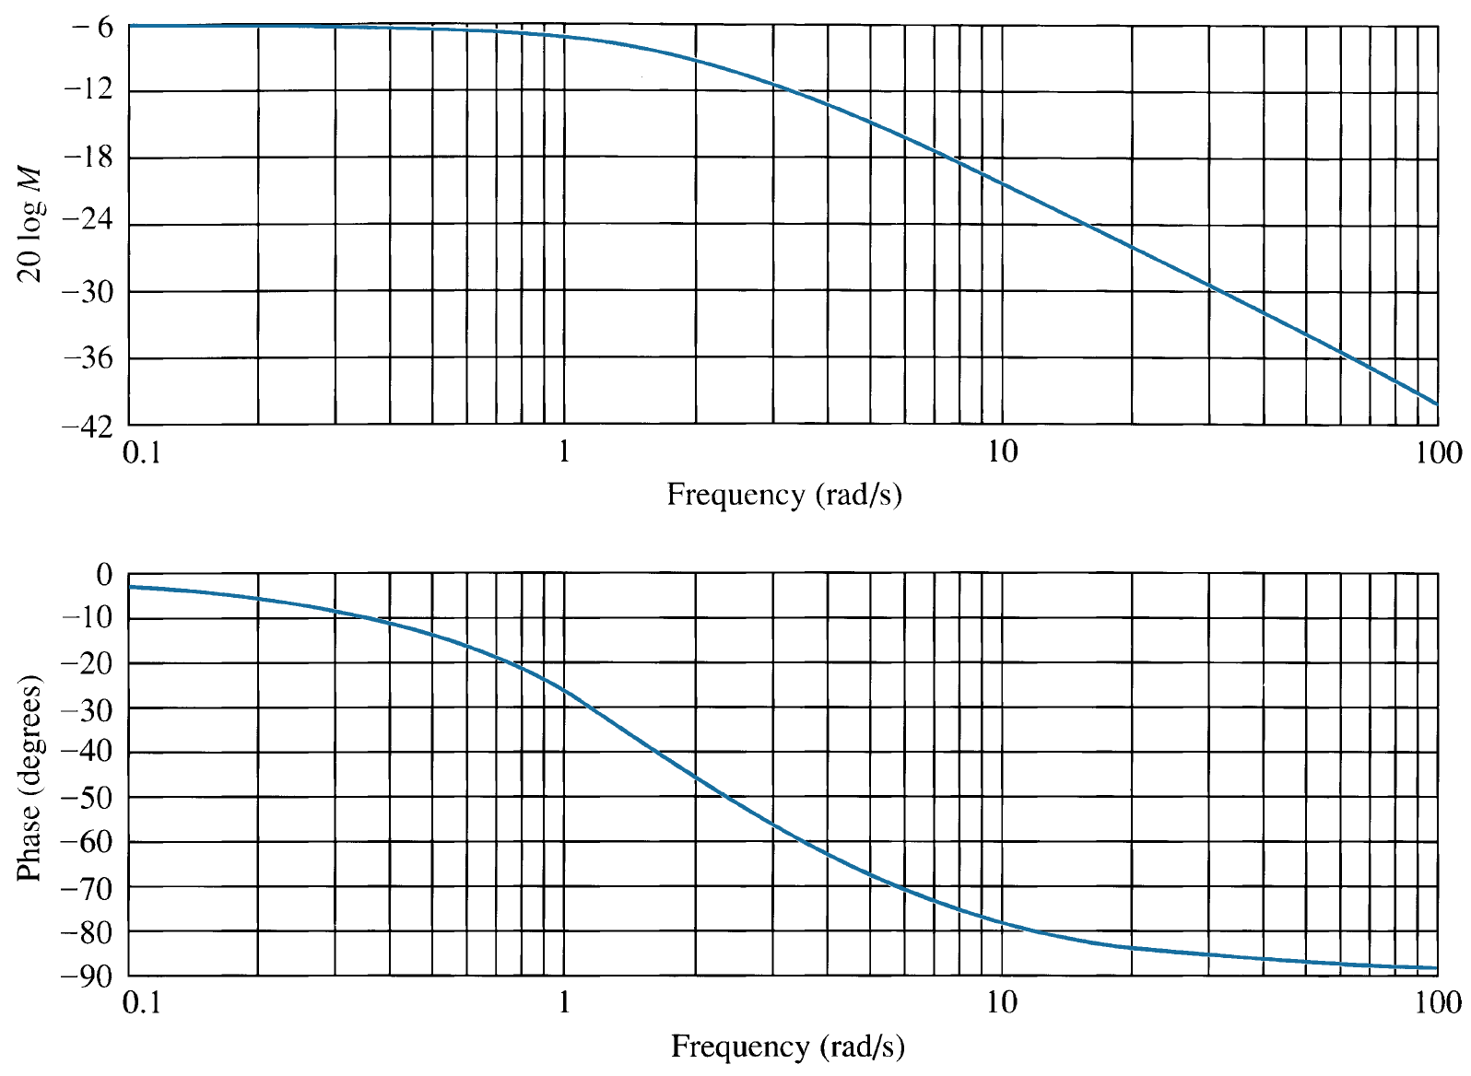
Frequency response
plots for G(s) = 1/(s + 2):

Slide 10
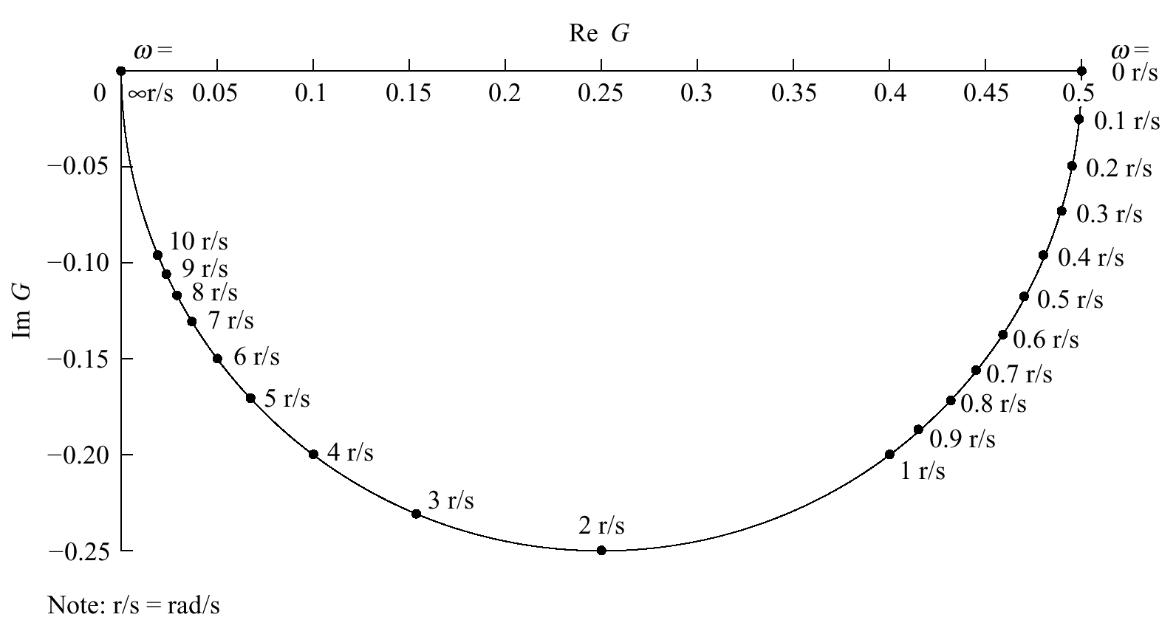
Frequency response
plots for G(s) = 1/(s + 2): polar plot

Slide 11
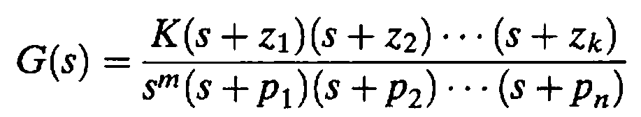
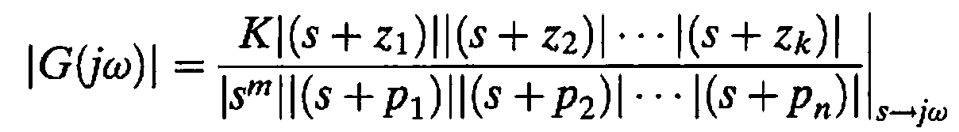
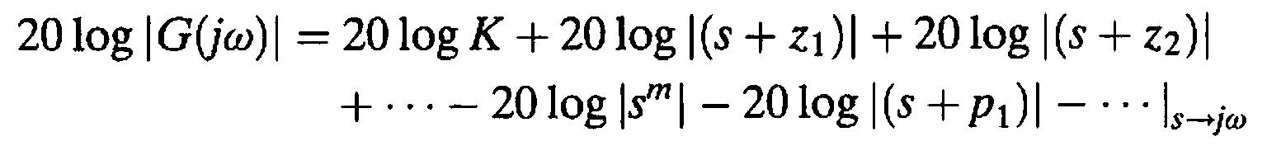
Asymptotic approximation : Bode Plots
The magnitude response may expressed as:
Converting into dB

Slide 12
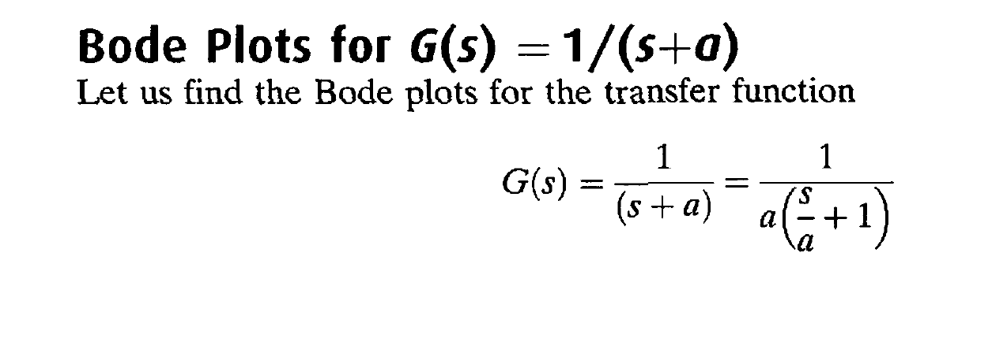
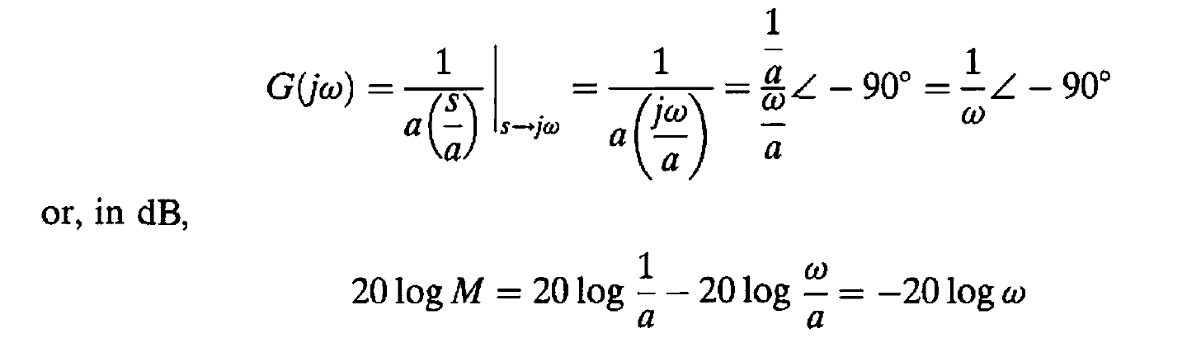
Asymptotic approximation : Bode Plots

Slide 13
Frequency response
plots for G(s) = 1/(s + 2):
Asymptotic approximation

Slide 14

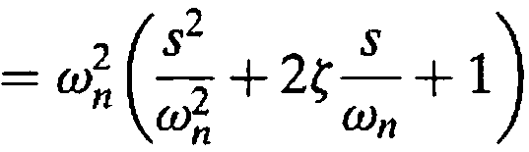
The second-order polynomial is of the form:
Asymptotic approximation
Difference between the asymptotic approximation and the actual frequency response curves.

Slide 15
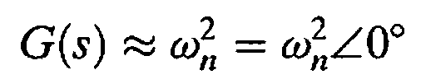

At low frequencies
The magnitude, M, in dB at low frequencies
At high frequencies
The log-magnitude is
The low-frequency and the high-frequency asymptotes
are equal when
ω = ω_{n}

Slide 16
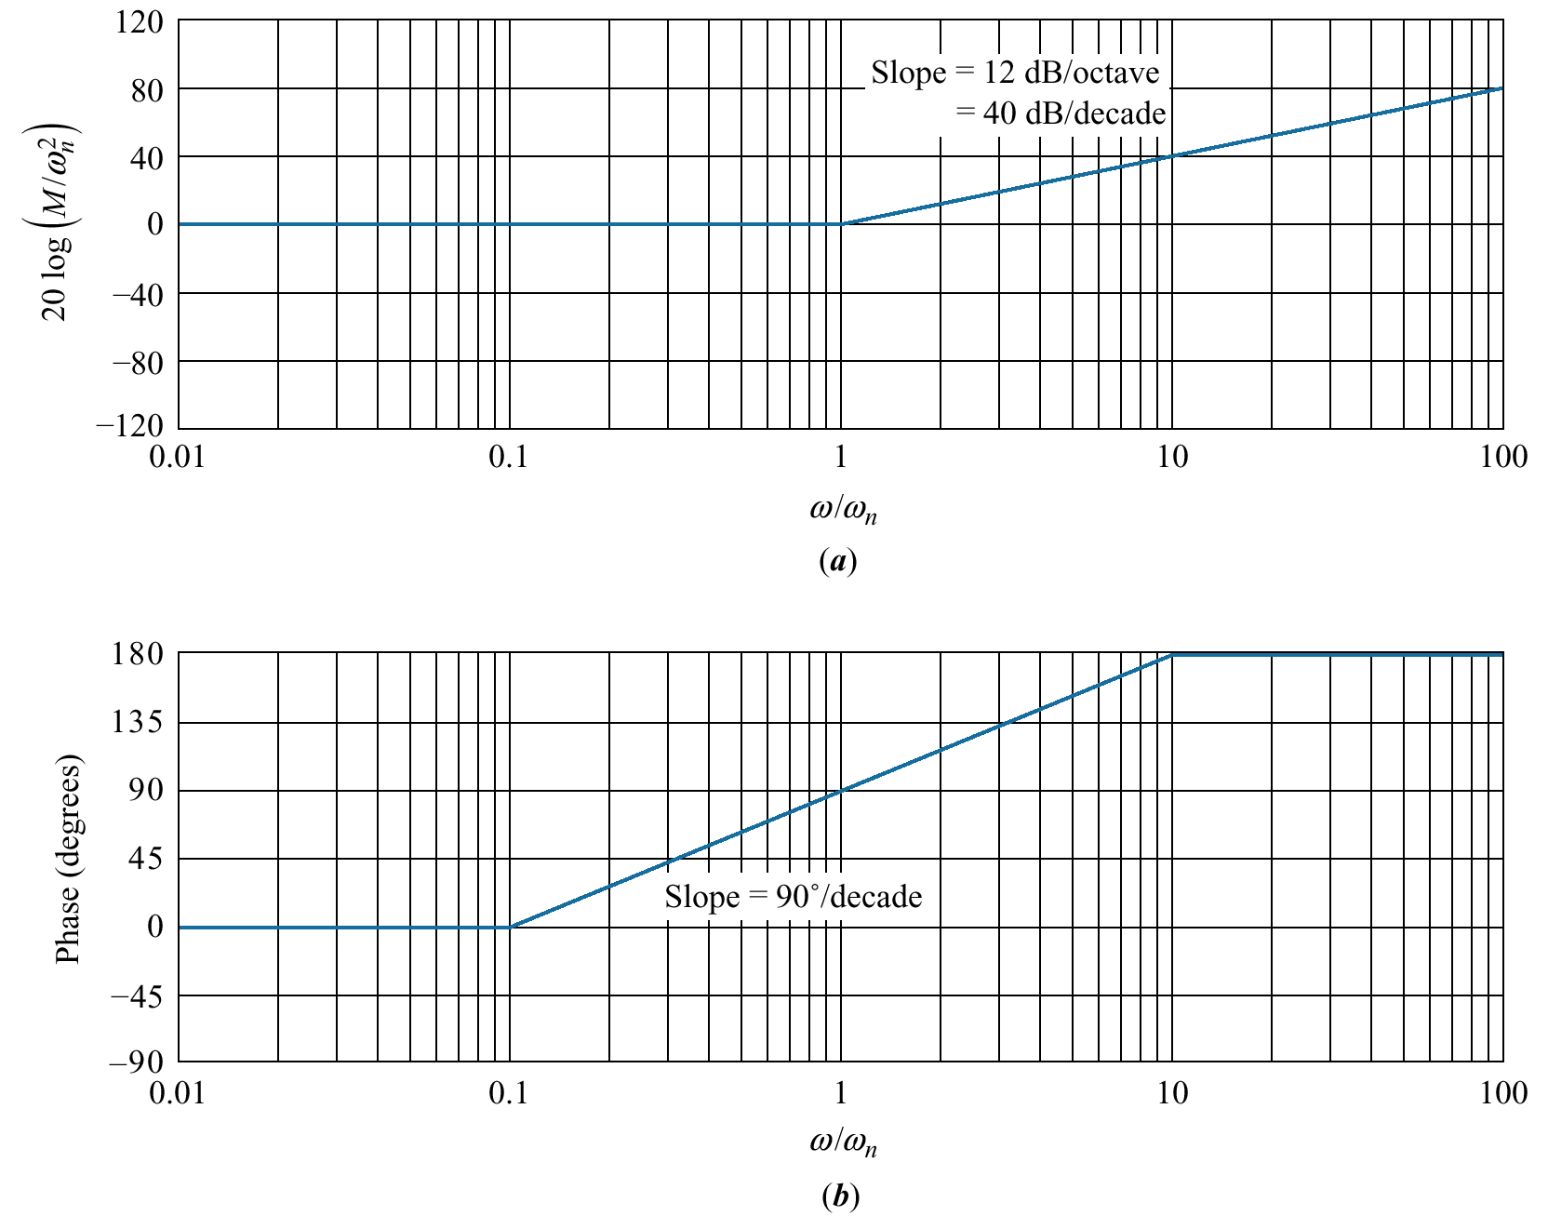
Bode asymptotes for normalized and scaled

Slide 17
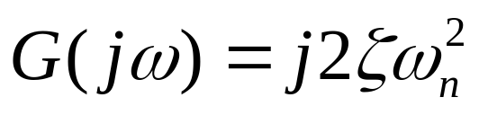
At natural frequency (ω = ω_{n})
The phase angle at natural frequency is +90 degrees

Slide 18
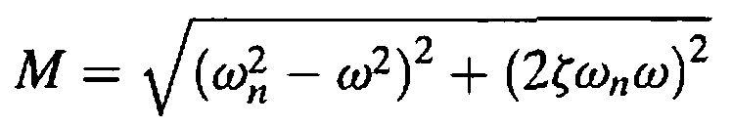
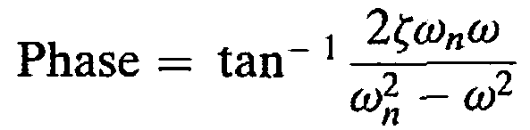
The first-order polynomial has a disparity of no more than 3.01 dB magnitude and 5.71° phase,
The second-order function may have a greater disparity, which depends upon the value of ζ
The actual magnitude and phase for G(s) are:

Slide 19
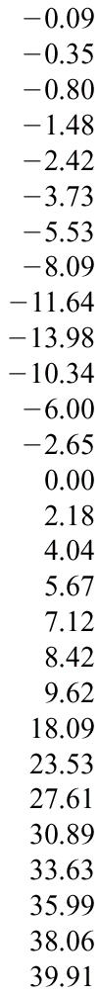
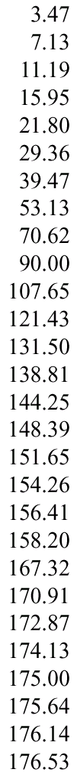
Freq.
ω/ω_{n}
Mag
(dB)
ζ = 0.1
Phase
(deg)
ζ = 0.1
Mag
(dB)
ζ = 0.2
Phase
(deg)
ζ = 0.2
Mag
(dB)
ζ = 0.3
Phase
(deg)
ζ = 0.3
Data for normalized and scaled log-magnitude and phase plots for
(s² + 2zw_{n}s + w_{n}²). Mag = 20 log(M/w_{n}²)

Slide 20
Table
(continued)
Freq.
ω/ω_{n}
Mag
(dB)
ζ = 0.5
Phase
(deg)
ζ = 0.5
Mag
(dB)
ζ = 0.7
Phase
(deg)
ζ = 0.7
Mag
(dB)
ζ = 1
Phase
(deg)
ζ = 1

Slide 21
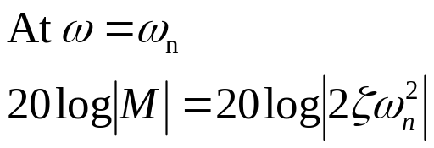
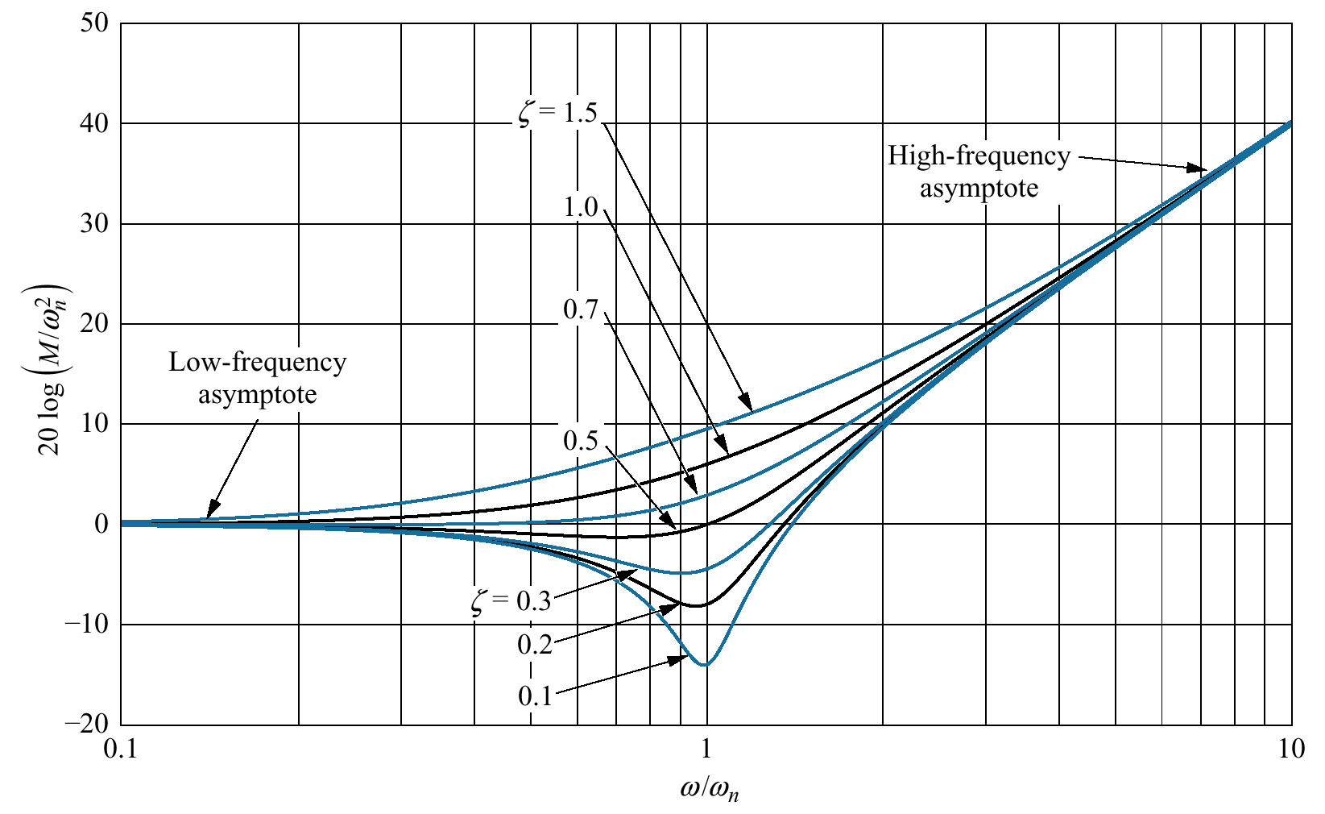
Normalized and scaled
log-magnitude response for
s² + 2ζω_{n}s + ω_{n}²

Slide 22

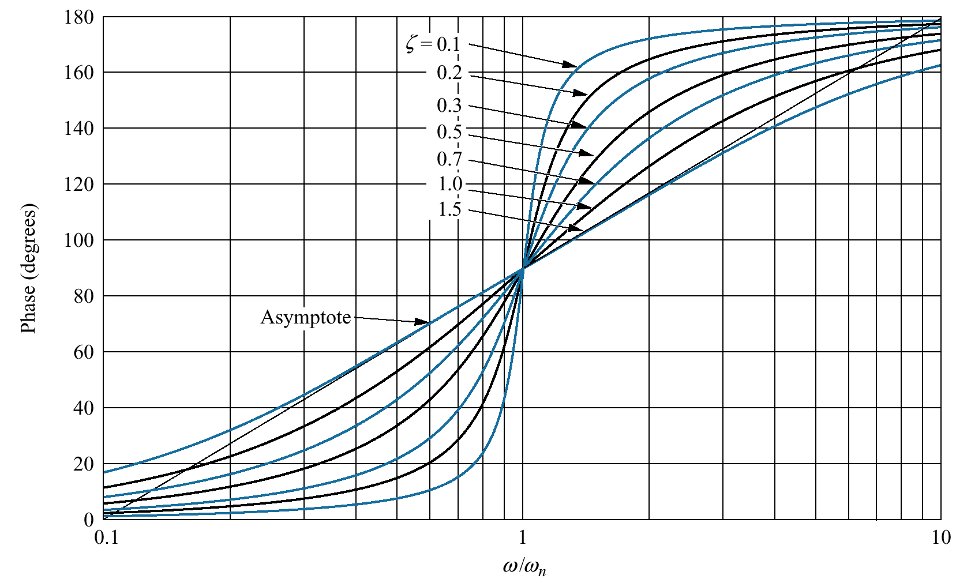
Scaled phase response for

Slide 23

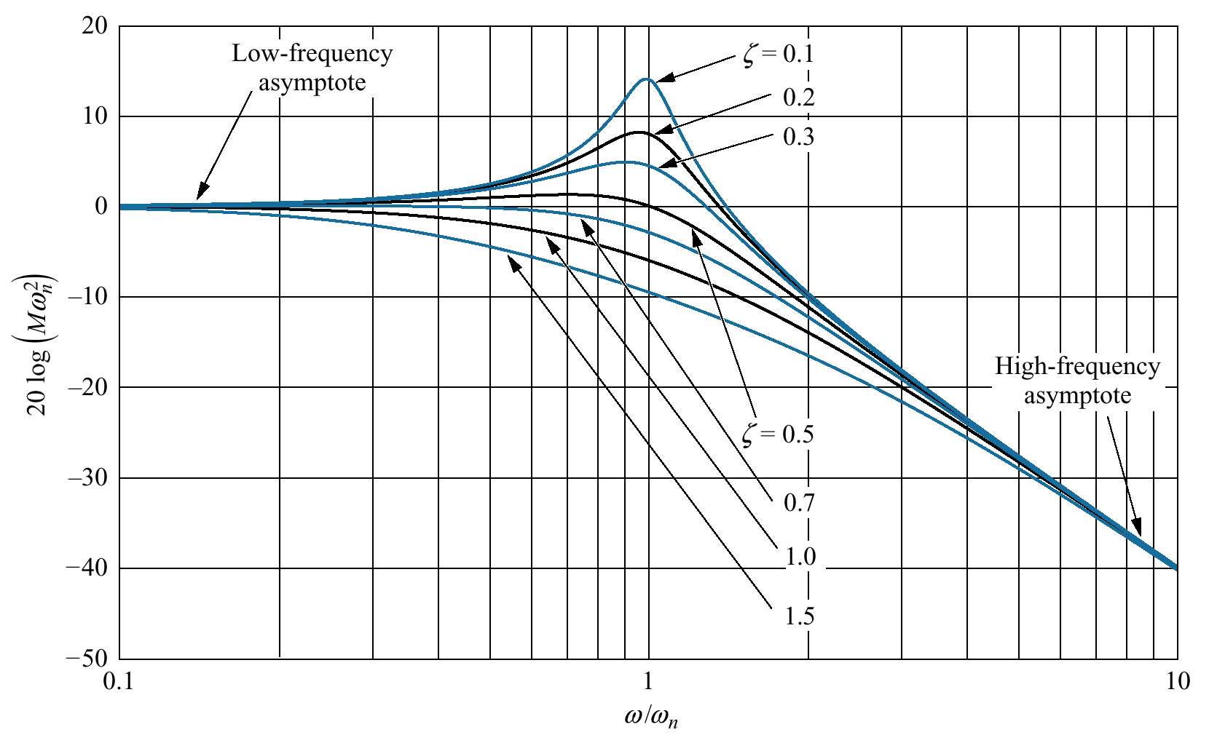
Normalized and scaled log magnitude
response for

Slide 24
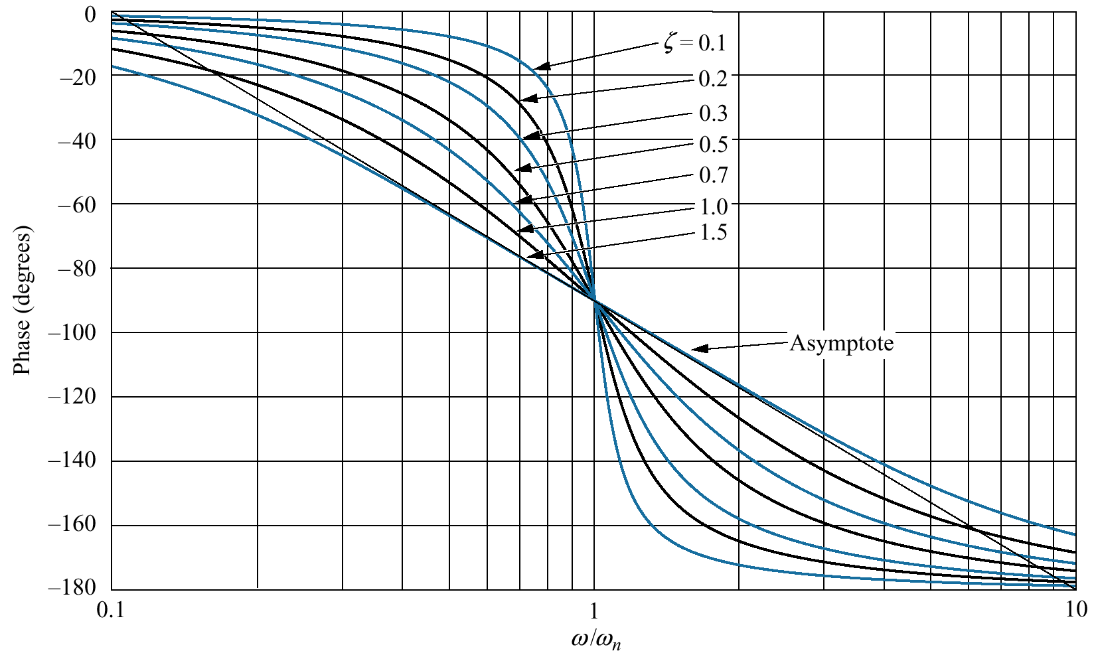
Scaled phase response for

Slide 25
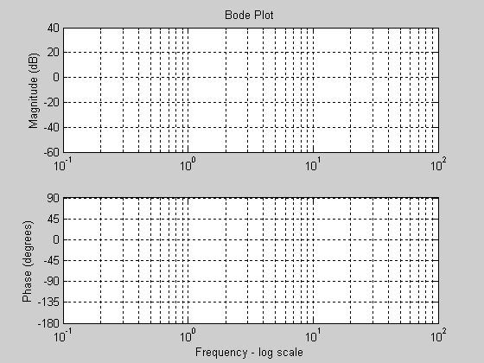
Bode magnitude
plot for G(s) = (s + 3)/[(s + 2)(s² + 2s + 25)]:

Slide 26
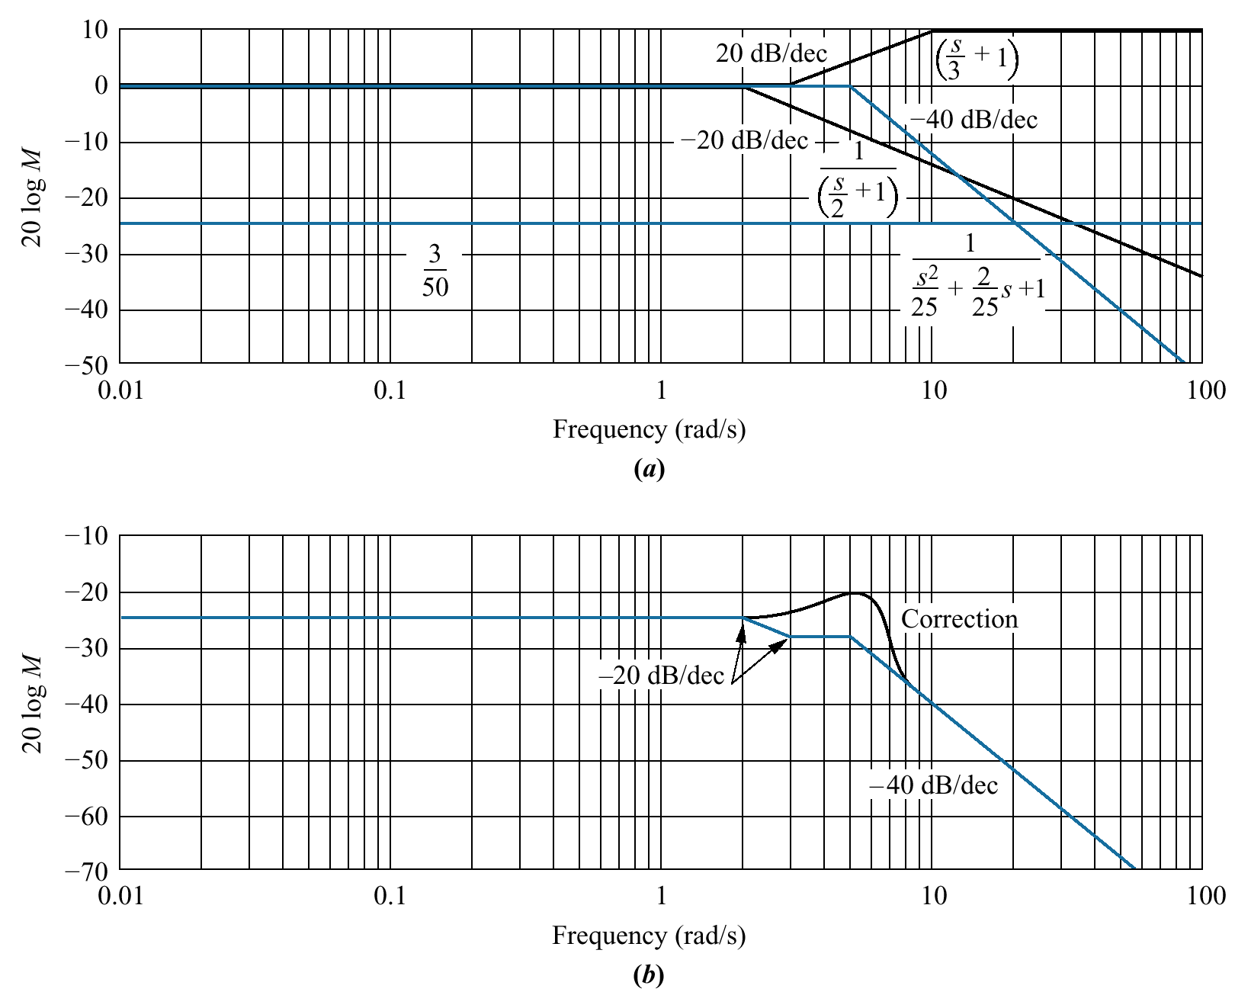
Bode magnitude
plot for G(s) = (s + 3)/[(s + 2)(s² + 2s + 25)]:

Slide 27
Work out and understand example 10.3

Slide 28
10.7: Stability, Gain Margin and Phase margins via Bode Plot

Slide 29
Gain Margin
The gain margin is found by using the phase plot to find the frequency, where the phase angle is 180°. At this frequency, we look at the magnitude plot to determine the gain margin, G_{M} , which is the gain required to raise the magnitude curve to 0 dB.
Phase Margin
The phase margin is found by using the magnitude curve to find the frequency, where the gain is 0 dB. On the phase curve at that frequency, the phase margin, Φ_{M} , is the difference between the phase value and 180°.

Slide 30
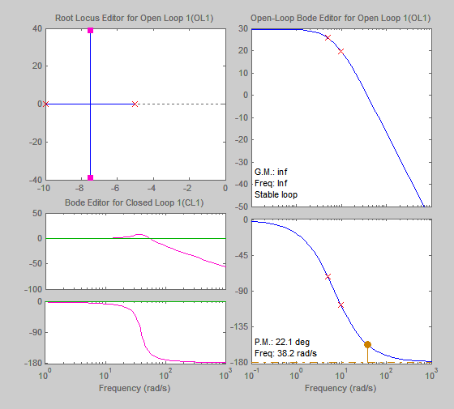
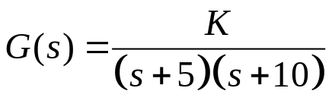

Slide 31
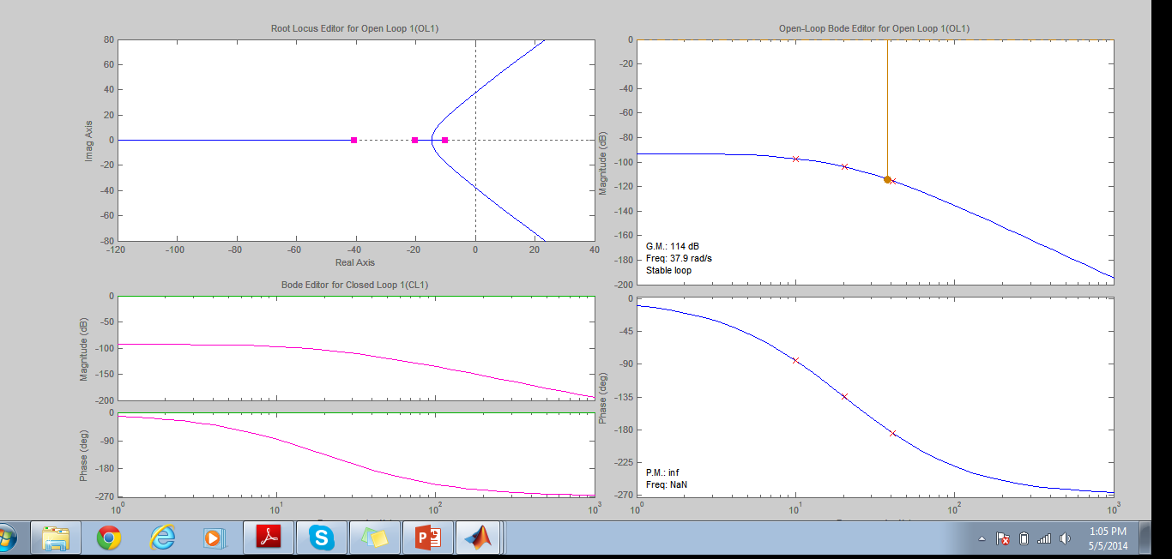
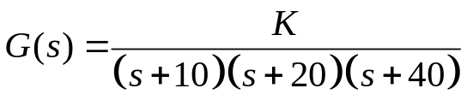

Slide 32
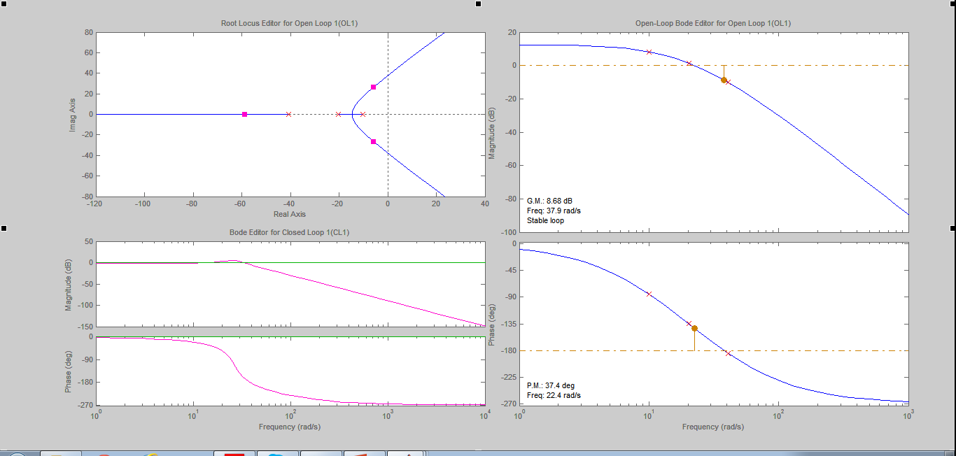


Slide 33
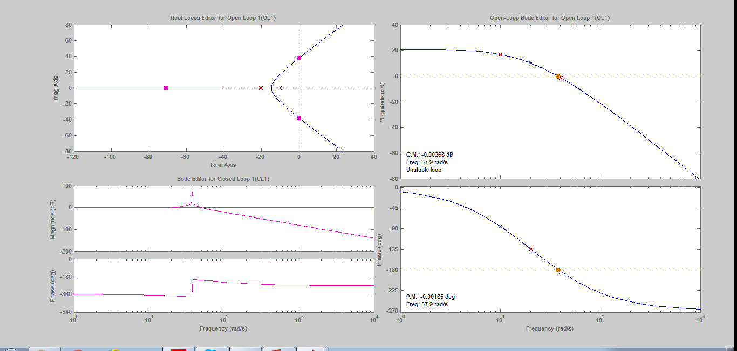


Slide 34
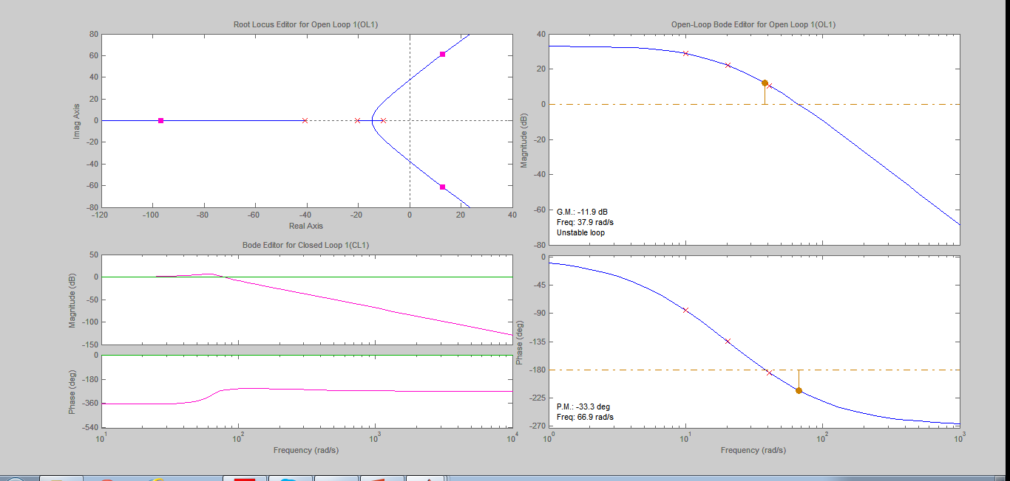


Slide 35
10.8 Relation Between Closed-Loop Transient and Closed-Loop Frequency Responses

Slide 36
Damping Ratio and Closed-Loop Frequency Response

Slide 37
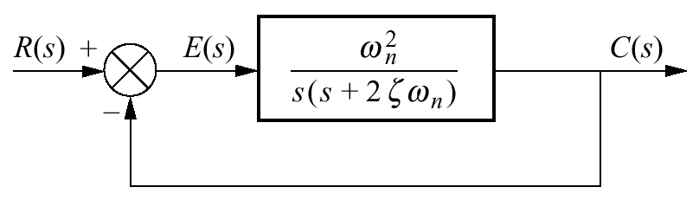
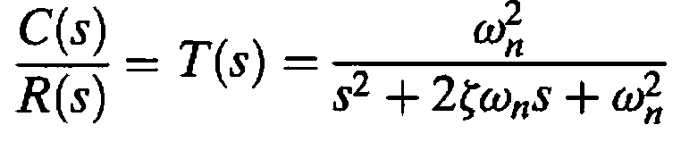
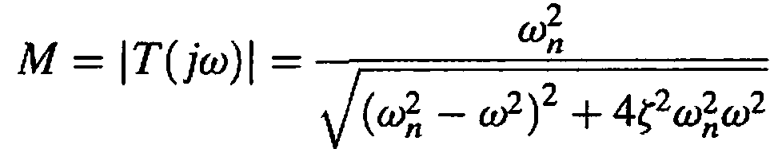
Relationship between a system's transient response and its closed-loop frequency response
Find the frequency response
Define characteristics of this response
Relate these characteristics to the transient response
Magnitude of the closed-loop frequency response

Slide 38



The maximum magnitude is directly related to the damping ratio and, hence, the percent overshoot
There will not be a peak at frequencies above zero if ζ > 0.707

Slide 39

Since ζ is related to percent overshoot,
we can plot Mp vs. percent overshoot

Slide 40
Response Speed and Closed-Loop Frequency Response

Slide 41




The speed of the time response is related to the bandwidth of the closed-loop frequency response
Similarly, relationship between ω_{BW}, Tr, and ζ can be established
The frequency, ω_{BW}, at which the magnitude response curve is 3 dB down from its value at zero frequency

Slide 42

Normalized bandwidth vs. damping ratio for:
a. settling time;
b. peak time;
c. rise time

Slide 43
10.10 Relating Damping Ratio and Phase Margin

Slide 44
Damping Ratio and Phase Margin

Slide 45








To evaluate the phase margin, first find the frequency for which |G(jω)| =1
The difference between this angle and -180° is the phase margin, Φ_{M}

Slide 46

Phase margin vs. damping ratio

Slide 47
Steady-State Error Characteristics
from Frequency Response

Slide 48




Position Constant
To find K_{p}, consider the Type 0 system
The initial value is
A typical unnormalized and unscaled Bode log-magnitude plot

Slide 49





Velocity Constant
To find K_{v}, consider the open-loop transfer function of a Type 1 system
The Bode plot starts at

Slide 50





Acceleration Constant
To find K_{a} , consider the Type 2 system
The Bode plot starts at

Slide 51
Example 10.14
Static Error Constants from Bode Plots
^{PROBLEM:}
For each unnormalized Bode log-magnitude plot shown in Figure,
^{a. Find the system type.}
b. Find the value of the appropriate static error constant.

Slide 52


Slide 53

???

